Slide 1
Phonics at Temple Ewell

Slide 2
What is phonics?
Phonics is a method through which pupils are taught how to read and write. Through phonics reading, they will learn how to make connections between sounds and the symbols that we use to represent them. There are different types of English phonetics and different methods for teaching it.
Children studying phonics learn to read and write using phonics, which is by directly linking phonemes (sounds in words) and graphemes (the symbols used to represent them). Through reading in phonics, children will begin to understand which sounds correspond to which symbols. Once they’ve mastered this skill, they will be able to decode books and other texts.

Slide 3
Phonics Vocab
Phonics: Using the sounds made by individual letters and groups of letters to read words.
Decoding: Using your phonic knowledge to sound out and read words.
Grapheme: A written letter or group of letters, like ‘s’, ‘a’, ‘she’ or ‘air’. Some graphemes are single letters like ‘a’; others are digraphs like ‘ai’.
Digraph: Two letters that make one sound together, like ‘sh’, ‘ai’, ‘oo’.
Phoneme: The sound a letter or group of letters make – e.g. the word ‘mat’ has three phonemes, ‘m’, ‘a’ and ‘t’. The word ‘through’ is longer, but it also has three phonemes, ‘th’, ‘r’ and the ‘oo’ sound in ‘ough’.
Sounding out: Using your phonic knowledge to help you say each sound within a word, e.g. ‘r-e-d’ or ‘s-au-ce-p-a-n’.
Blending: Running the sounds in the word together to read the whole word, e.g. ‘r-e-d, red’, ‘s-au-ce-p-a-n, saucepan’.
High-frequency words (also known as ‘common exception words’): The very important, very common words that we use a lot, but which aren’t always decodable using phonics. This includes crucial words like ‘the’, ‘one’, ‘where’, etc. Children are taught to recognise these words on sight – a few of these words are introduced and learnt at a time.
Hopefully, these definitions will help you to 'decode' what phonics is about!

Slide 4
How do we teach Phonics at Temple Ewell?
Phonics is taught using phonics Bug Club Synthetic Phonics in Early Years and KS1 and the Rapid Phonics programme in KS2.
Reading skills are developed using Bug Club Phonics as well as also accessing a wide range of texts including the Book Banded Scheme.
Children are encouraged to take books home to share with their parents and carers on a daily basis, and KS1 children can also access Bug Club Phonics reading interactively at home.
Children develop a love of reading and practice their reading skills regularly each day in all areas of the curriculum through reading aloud, independent reading and focused and shared reading activities.
Children are split into year group (Miss Demetri Reception, Mrs. Tidey Year 1)These can change for individual children.

Slide 5

Bug Club
Bug Club is a finely levelled, phonically based online reading scheme with interactive activities. Each child has a personalized homepage where they'll find the e-Books they've been allocated by the teacher and motivating rewards. This ensures that each child can find a book at exactly the right level for them.

Slide 6
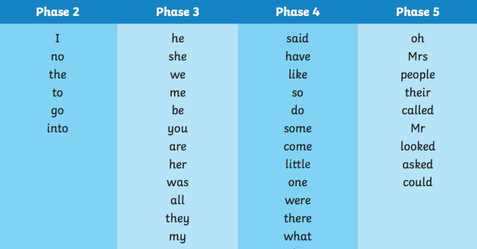
Phonics phases
Phase 1
Phase 1 phonics is linked directly to phonological awareness and phonemic awareness. Phonological awareness allows children to recognise and work with the initial sounds of spoken language. Phonological awareness is the awareness of all of the speech sounds of language.
Irregular ‘ tricky’ words

Slide 7
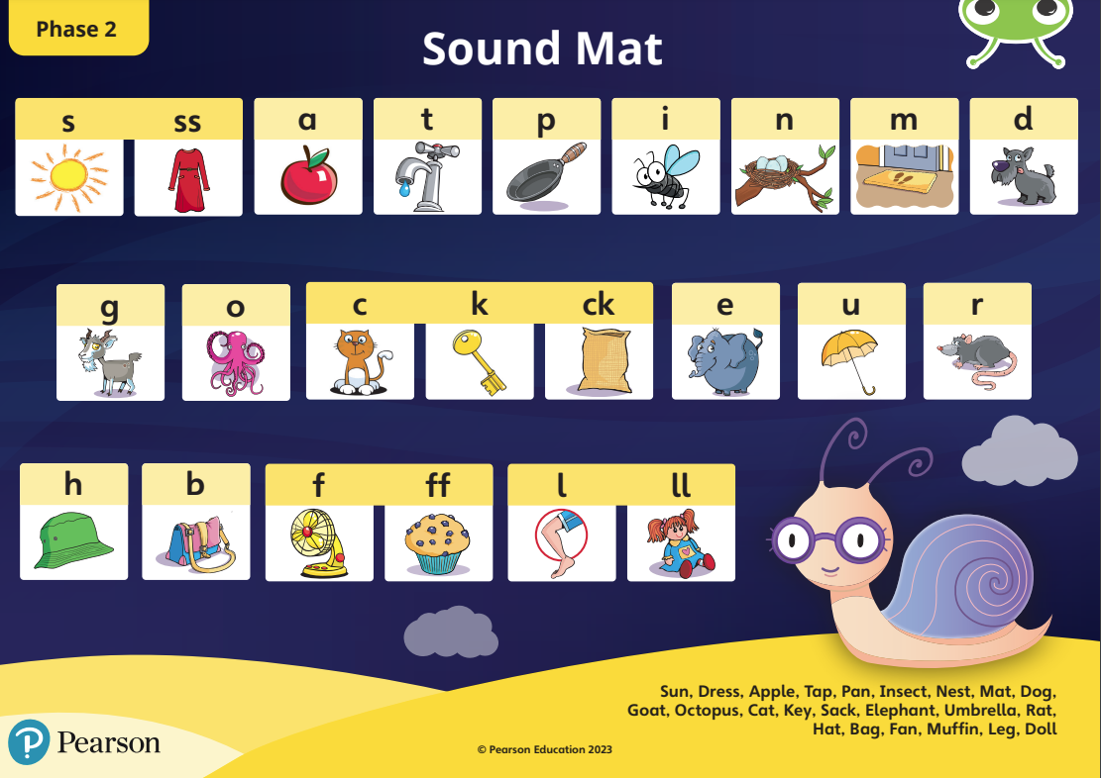
Reception

Slide 8
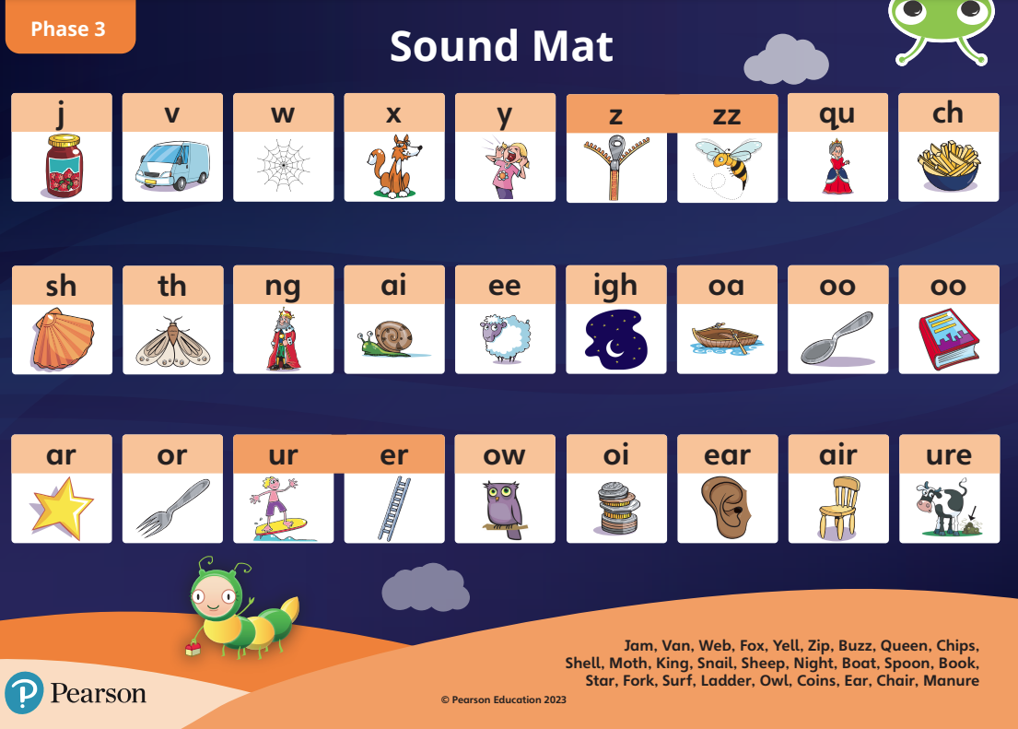
Reception

Slide 9
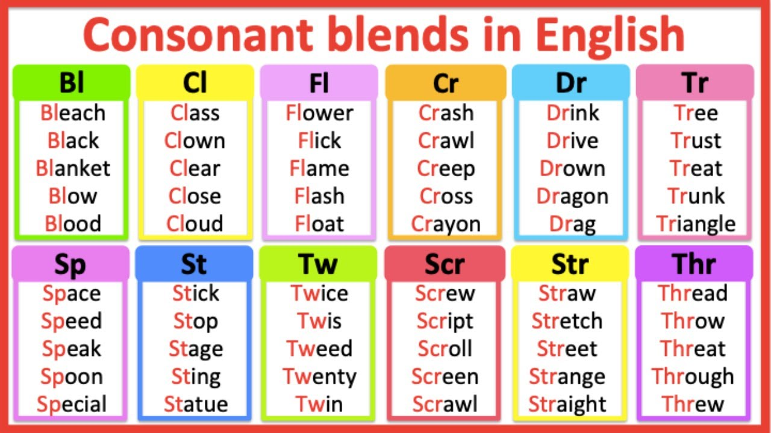
Phase 4
Blending separate sounds together to read words with adjacent consonants
Recapping phase 2 & 3 and practicing consonant blends e.g.
Reception
And Year 1

Slide 10
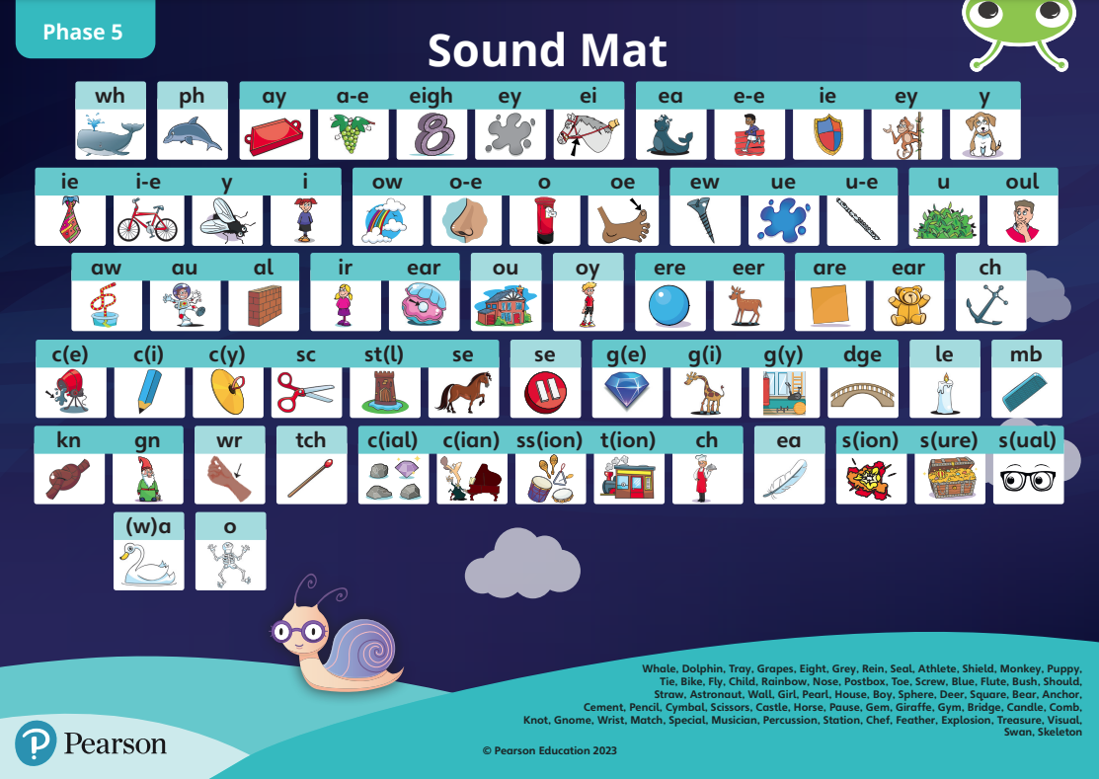
Year 1

Slide 11
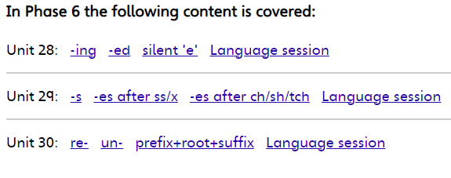
Phase 6
Year 1

Slide 12
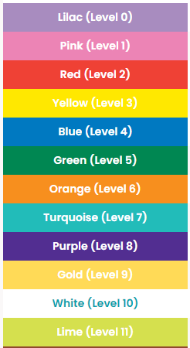
Book bands
Reading book bands can be used from Reception all the way through to year 6; however, they used to only be used through to year 2, with the expectation that year 3 and beyond should be working towards stronger reading fluency.

Slide 13
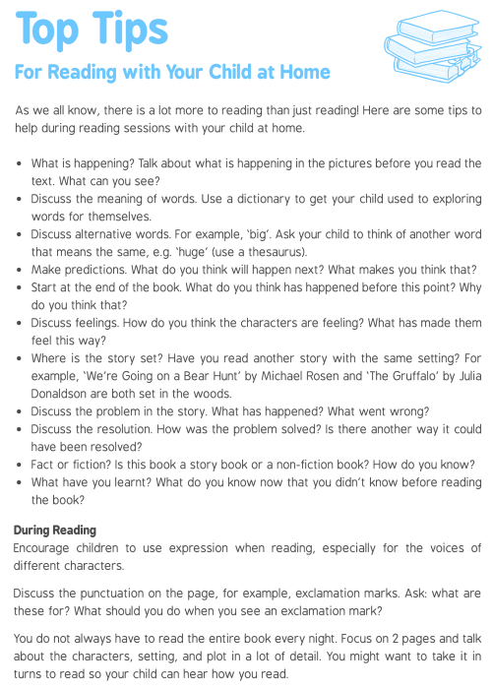

Slide 14
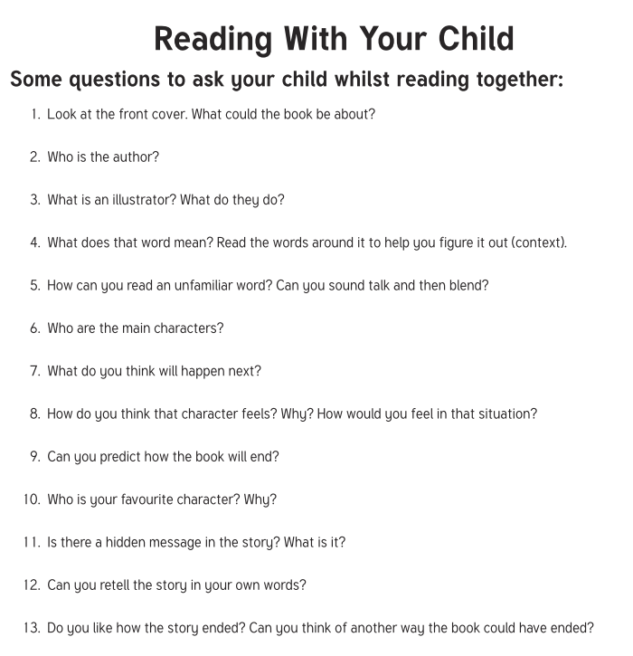
Top tip!
If you can’t read a word, sound it out!

Slide 15
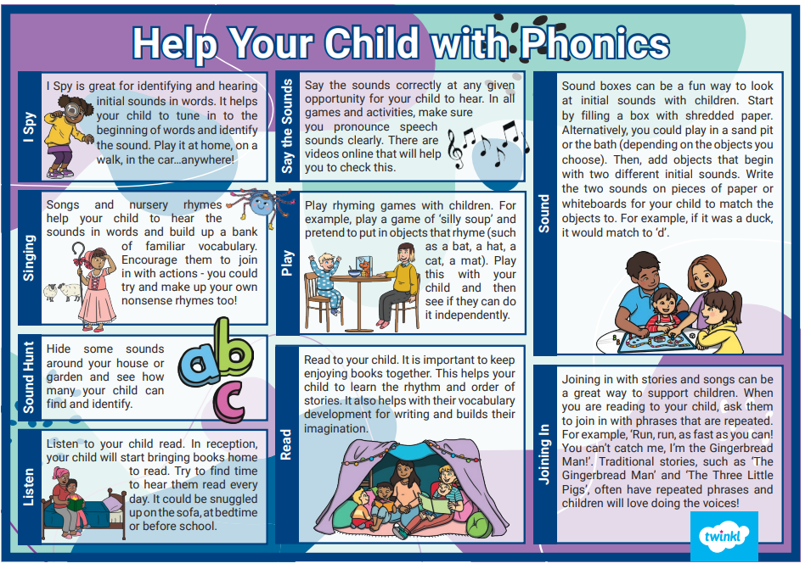

Slide 16
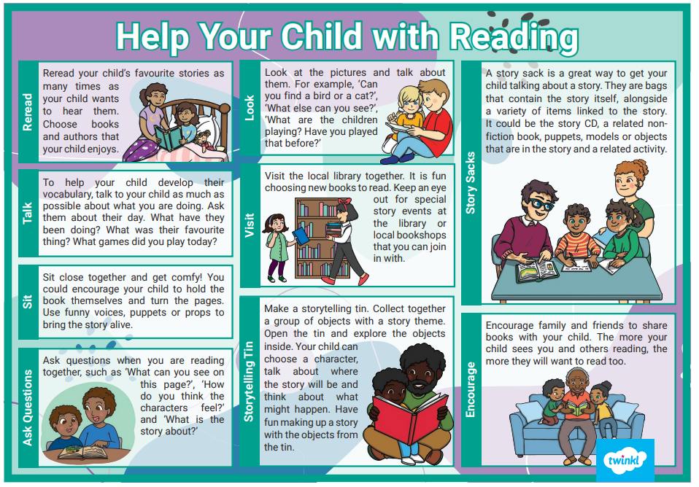

Slide 17
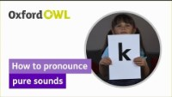
How to pronounce phonemes correctly
Top tip!
Point to words as you read them and read back whole sentences!
https://www.youtube.com/watch?v=UCI2mu7URBc

Slide 18

How to log into bug club
Go to https://www.activelearnprimary.co.uk
Enter your log in details.
Your child’s homepage will appear
Please teach your child to log onto their bug club profile independently as they will need to do this as part of their learning.
Here is a tutorial https://www.youtube.com/watch?v=IlxKN--UYh4 of how to log on.

Slide 19

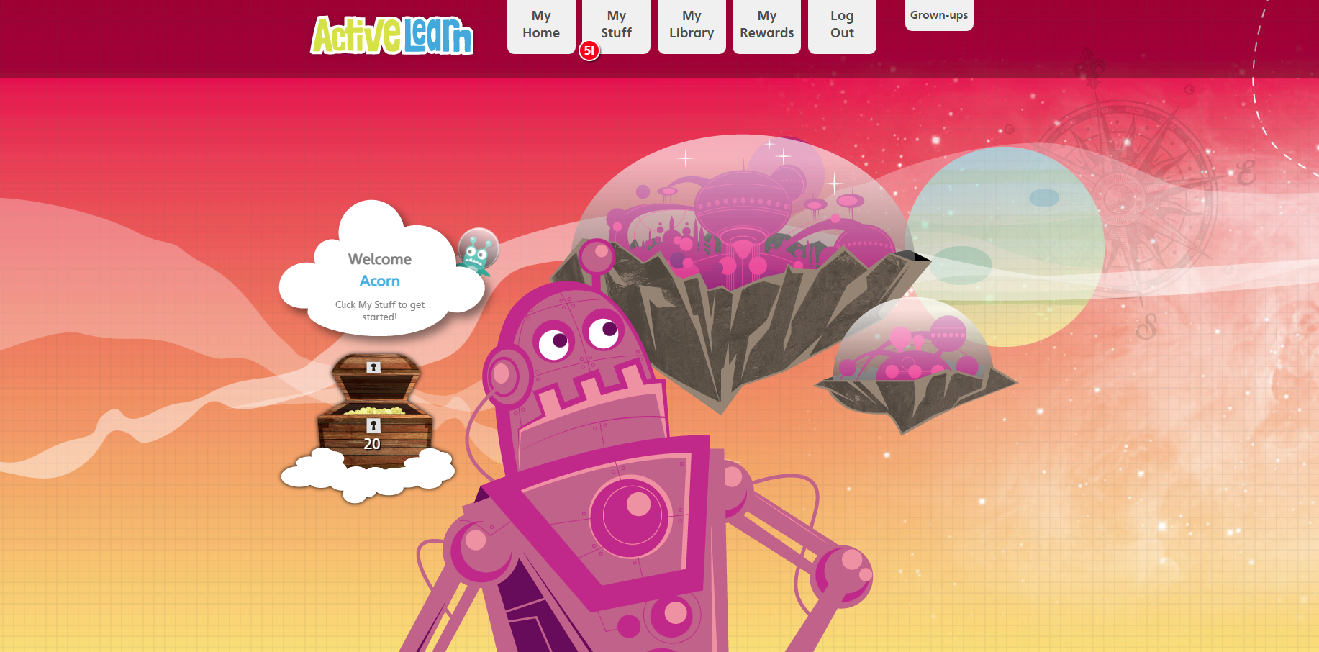
Parent tab on bug club
Go to your child’s bug club account and click on the ‘Grown-ups’ tab to see lots of extra information and helpful hints!

Slide 20
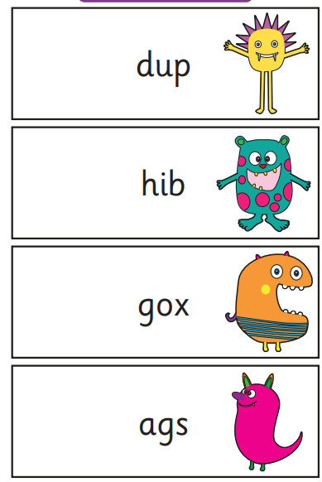
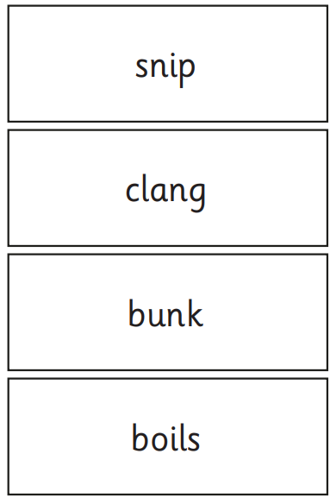
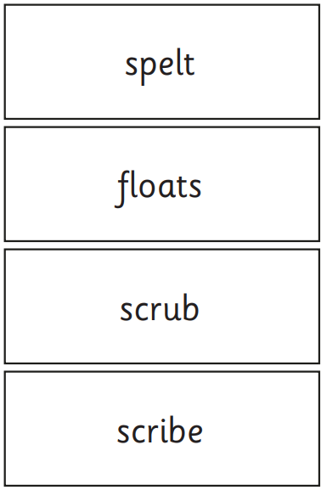
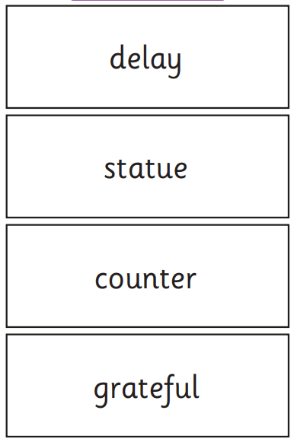
The phonics test
Year 1

Slide 21
Phase 1 activities you can do at home!
Please see the link below for some games and activities you can try at home to help secure phase 1 phonic skills!
https://www.tameside.gov.uk/TamesideMBC/media/education/VS-Phase-1-Games-to-Play-at-Home.pdf

Slide 22
Phonics games to play at home
Word / grapheme hunt – hide the graphemes/words around the house and get your child to find them, can you pronounce the phoneme?
Post it words – choose six letters and make as many words as you can from those letters, can you swap a letter to change the word? E.g. s-i-t to s-a-t
Matching pairs – finding and reading matching words. Word cards could be hidden for your child to find
I spy
Guess my word… “My word begins with… m”
Ask your child what the initial sound of the word is.
Rhyming games
Grapheme dominoes
Real or alien word?
Bingo - reading and spelling words on a bingo board. Your child could read or spell different words and win bingo if they can read or spell words correctly.
Silly voices - say sounds in a high, low, happy or grumpy voice.
'Skip to it!' - run, jump, hop or skip to a certain word.
'Fishing for phonics' - 'fish' for words written on ping pong balls. The balls could be in the bath or hidden in the house. Your child could use a net to try and catch the balls.
Sing an alphabet song - have lots of fun learning an alphabet song. Then point to a letter and ask your child to tell you its letter name and sound.

Slide 23

Online phonics games
Topmarks https://www.topmarks.co.uk/english-games/5-7-years/letters-and-sounds
ICT games https://ictgames.com/mobilePage/literacy.html
Phonics play https://www.phonicsplay.co.uk/
Use your child’s bug club account!
We will upload games as well as books so keep an eye out.
Your child will get online rewards for completing games and reading books!
We have a sent home the purple mash logins – let us know if you need another copy
https://www.purplemash.com/sch/temple-ct16#/
Don’t forget to click on the green bug and complete the activities at the beginning and end of the book to earn your rewards!

